Slide 1
ECES450-650
Tutorial 10
Taxonomic Classification of Sequences from WGS Using DIAMOND
Phil Huddy, Steven Lee, & Jacob Wong
Notes:
Jake

Slide 2
Overview
What is DIAMOND?
How can we use it for taxonomic classification?
What’s the process?
What have we learned?
Notes:
Jake

Slide 3
01
02
03
Taxonomic Classification
BLAST
DIAMOND
04
05
06
Kraken2 Datasets
UniprotKB
Tutorial Walkthrough
Notes:
Jake

Slide 4
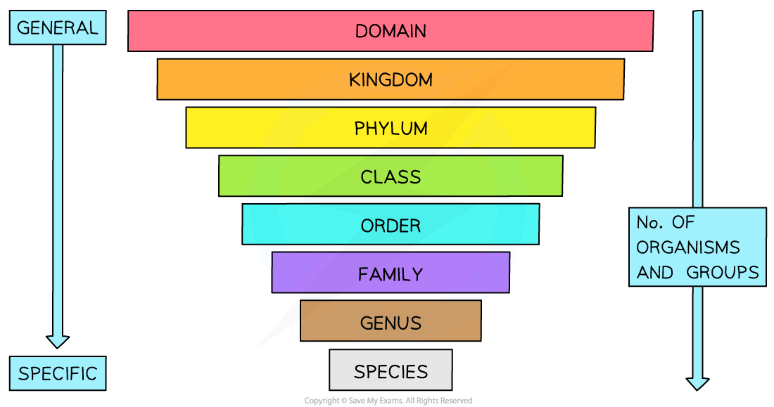
Taxonomic Classification
Notes:
Jake

Slide 5
BLAST
BLAST(Basic Local Alignment Search Tool)
Can rapidly align and compare DNA Sequence queries
The gold standard for alignment tools
Notes:
Jake

Slide 6
DIAMOND (Why it rocks!)
Protein aligner similar to BLAST
Trades sensitivity for speed
Built for large dataset queries
Old version of DIAMOND while practical, was not sensitive enough to provide useful insights comparatively to BLAST
DIAMOND 2.0 forgoes both to create a still fast yet highly sensitive aligner solution comparable to BLAST
Notes:
Jake

Slide 7
Diamond Under the Hood
Double indexing
Hamming distance filter
Ungapped extension
Leftmost seed filter
Adaptive ranking
Gapped extension filter
Chaining
Banded SWIPE
Frameshift alignments
Repeat masking
Distributed-memory parallelization
Notes:
Jake
Double indexing
Optimizes queries for large queries and dbs
Hashing and matching seeds(type of filter that allows gaps)
Improves upon the previous sorting technique
Both query and reference sequence (seed and location)
Hamming distance filter
Used during the first stage of the sequence comparison process to compare query and subject sequences
Ungapped extension
Next step after hamming which finds the ungapped extensions at seed hit locations
Leftmost seed filter
Used to delete duplicate alignments caused by double indexing
Adaptive ranking
Uses ungapped extension scores at seed hits to assign linear order to targets. Offers better reporting accuracy due to a dynamic criterion compared to MMSEQs2
Gapped extension filter
fast heuristic algorithm used to find gapped extension scores and discard those that dont meet a user threshold
Chaining
computation for diagonal segments
Banded SWIPE
modified version of vertical swipe used to compute remaining extensions, (BLOSUM62 Matrix)
Frameshift alignments
allows for shift up to 3 frames of strand aligned against a target sequence
Repeat masking
eliminates false positive hits of similarities rather than true relationsships
Distributed-memory parallelization
splits query and reference databases into chunks for parrallelized runs

Slide 8
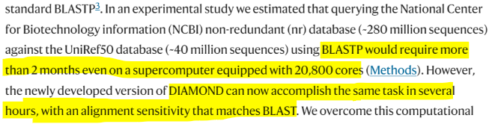
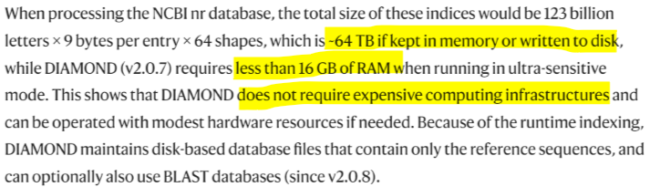
Performance and Resources
Notes:
Steven
DIAMOND is much faster than BLAST
DIAMOND also requires less resources than BLAST
Buchfink, B., Reuter, K. & Drost, HG. Sensitive protein alignments at tree-of-life scale using DIAMOND. Nat Methods 18, 366–368 (2021). https://doi.org/10.1038/s41592-021-01101-x

Slide 9
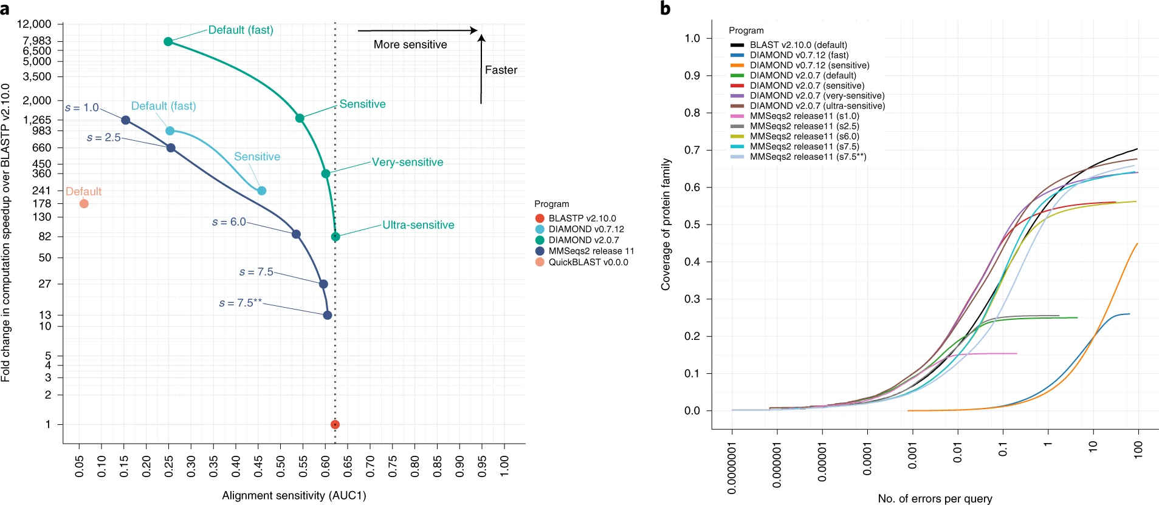
Speed & Sensitivity Graph
Notes:
Steven
DIAMOND 2.0 offers multiple sensitivity modes. While previous versions of DIAMOND were only fast and sacrificed sensitivity.
As you can see with the Ultra-sesnitive mode, DIAMOND is not only equivalently sensitive but much faster than the BLAST counterpart

Slide 10
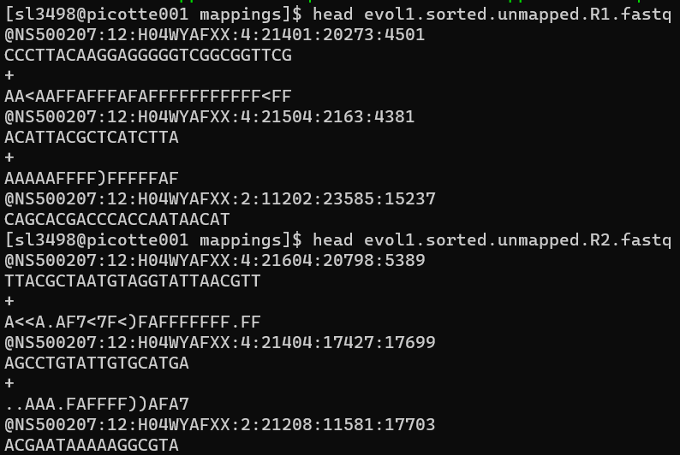
Kraken2 Datasets
Notes:
Steven
2 Kraken2 datasets used are in the fastq format originally
The images show just the head of the files
Line 1 begins with @ followed by sequence identifier
Line 2 has the raw sequence letters
Line 3 has the ‘+’ character
Line 4 encodes the quality values for the sequence in Line 2, and must contain the same number of symbols as letters in the sequence
Here we can also verify that these are DNA sequences
To use these as query files in DIAMOND we were able to directly use these in the fastq format

Slide 11
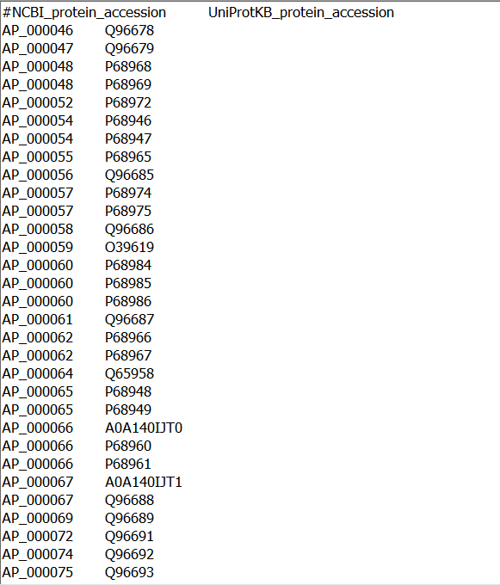
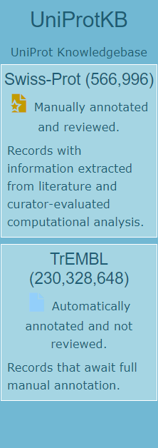
UniprotKB
Notes:
Steven
Left image shown is the contents of the UniprotKB file initially given
Left column shows the #NCBI_protein_accesion
Right column shows the UniProtKB_protein_accession
UniprotKB is a widely used database of protein sequence and functional annotation data
Composed of "UniProtKB/Swiss-Prot" (reviewed, manually annotated) and "UniProtKB/TrEMBL" (unreviewed, automatically annotated), respectively.
Swiss-prot ~500k
TrEMBL ~230 million
We combined both the Swiss-prot and TrEMBL into one in our analysis

Slide 12
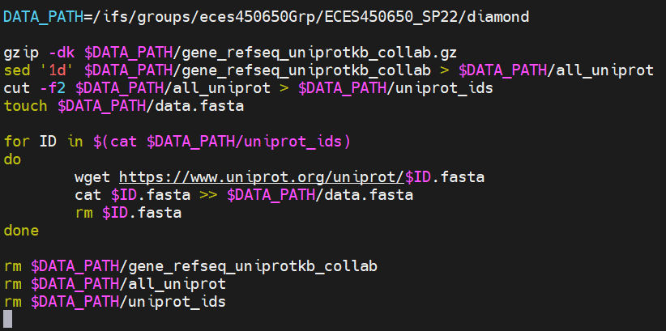
Importing the data
Notes:
Phil
Only got data for ~50,000 proteins in 10 hours
Total of ~46,000,000 proteins
On pace for 383 days

Slide 13
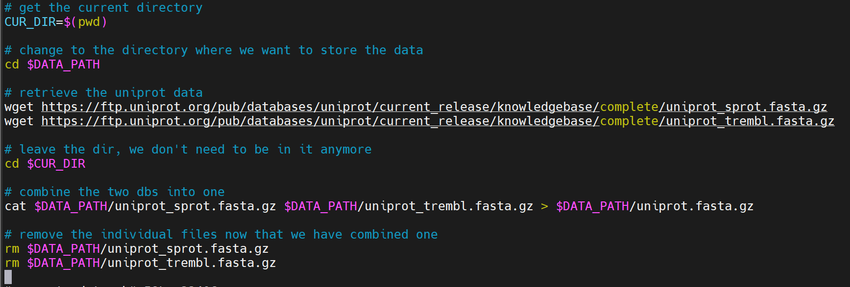
Actually importing the data
Notes:
Phil
Getting all uniprot data, which is ~235 million proteins, much more than the 46 million we were tasked with
Anyone can see the data in that directory

Slide 14
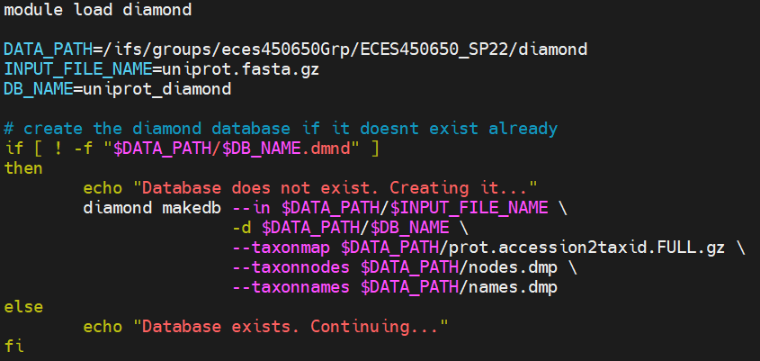
Creating the Diamond Database
Notes:
Phil

Slide 15
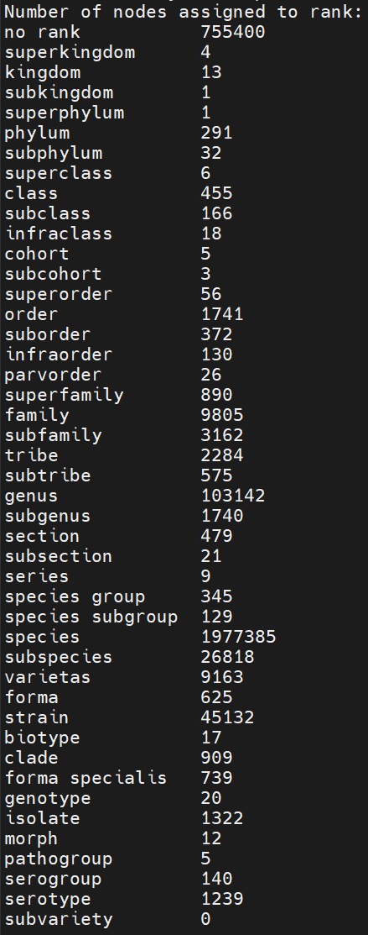
Taxon Nodes Summary

Slide 16
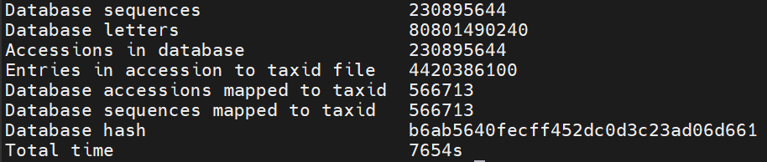
DB Summary
Notes:
106 gb

Slide 17
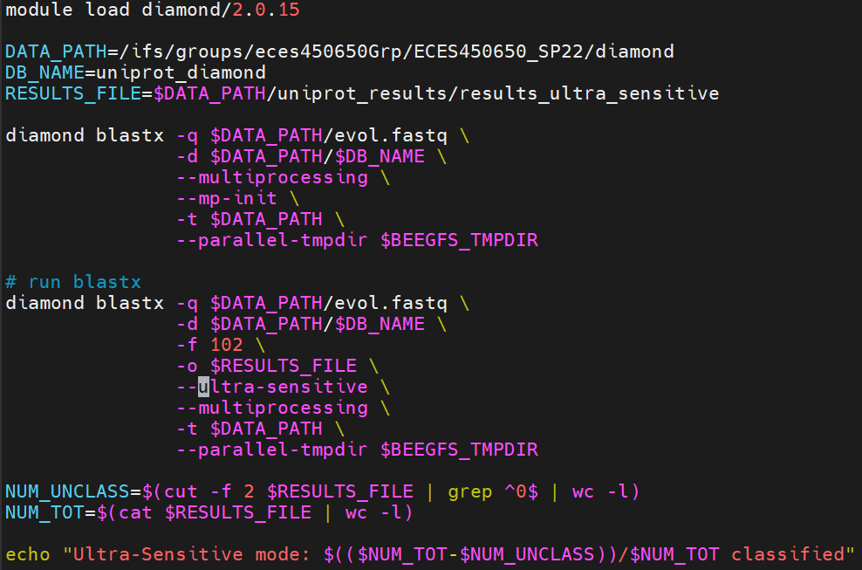
Running the alignments
Notes:
Phil
-q query in fasta or fastq format
-d database file
-f is format
- 102 is taxonomic classification
- can also use BLAST, SAM, and PAF
-sensitivity
Can change the scoring matrix, max expected e value, gap penalties, min score, and much more
Parallel jobs can be restarted if they crash, but couldn't figure it out on picotte

Slide 18
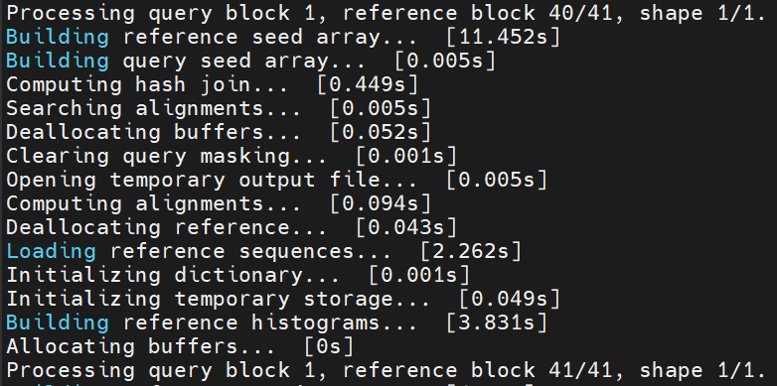
Running in Blocks

Slide 19
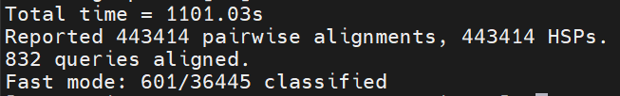
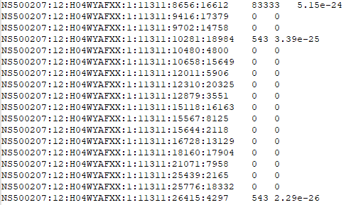
Fast Mode
Notes:
Phil
First column is query id
Second column is NCBI taxonomy id, or 0 if unclassified
Third column is E-value of the best alignment with a known taxonomic ID found for the query (0 if unclassified)

Slide 20
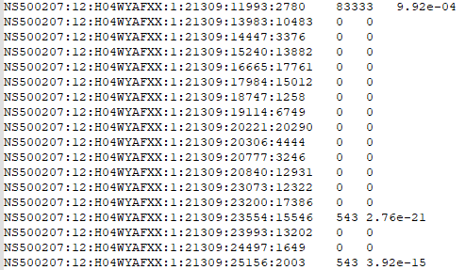
Mid Sensitive Mode

Slide 21

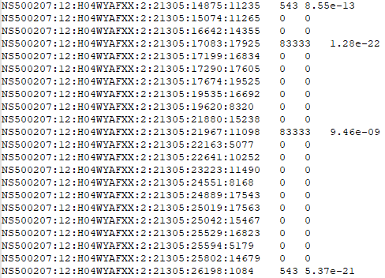
Sensitive Mode

Slide 22

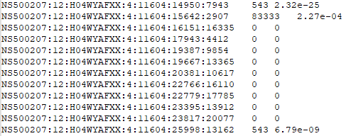
More Sensitive Mode

Slide 23
References
https://www.uniprot.org/help/uniprotkb
https://www.nature.com/articles/nmeth.3176.pdf?origin=ppub
https://www.nature.com/articles/s41592-021-01101-x
https://biologydictionary.net/taxonomy/
http://www.genomenewsnetwork.org/resources/whats_a_genome/Chp2_1.shtml
Notes:
Phil

Slide 24
Thank You!

